Slide 1
Università degli Studi di Modena e Reggio Emilia UNIMORE
Challenges and Future Opportunities of Hairpin Technologies
Dipartimento di Ingegneria "Enzo Ferrari"

Slide 2
Presentation topics
Electric vehicle power discussion
Power requirements
Power increment contributes
Round vs Rectangular conductors: Hairpin choice
Round conductor
Rectangular shape: Hairpin
Manufactory process of Hairpin
Manufactory main phases
Contacting techniques
Reference standard for sizing
Proposal architectures for motor design with hairpin
Standard Hairpin winding
Asymmetric Hairpins
Segmented Hairpins
Thermal comparison

Slide 3
Power requirements
Electrification of vehicle is taking relevant role in automotive, marine and aerospace.
Maximisation of power-to-weight and torque-to-weight ratios represents the primary objective.
Power requirements are increasing so the main aspects for design:
Torque
Speed
Winding technologies

Slide 4
Power icrement contributes
Torque | Speed
Air gap flux density E.g. improved electromagnetic properties of materials Linear current density E.g. new cooling systems and improved thermal management Operating conditions E.g. innovative tools of analysis, optimal control | Mechanical properties of materials E.g. increased yield strength with no impact on magnetic properties Optimal machine design E.g. optimal pole pair Number Parasitic effects E.g. compensation for skin effect, increased reliability
Winding technologies
Decrease winding resistance (larger wire diameters, reduced end winding lengths) Decrease AC parasitic effects (multi-stranded and optimal end winding shape) Increase fill factor

Slide 5
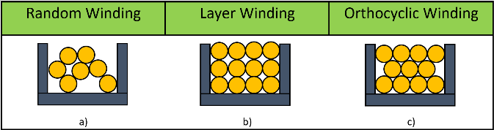
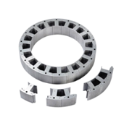
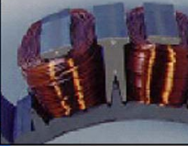
Round conductors
Basic winding pattern:
Stator design solution for winding positioning:
segmented stator,laminated plug-in tooth

Slide 6
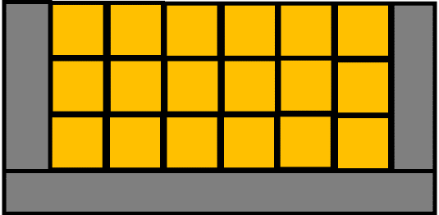
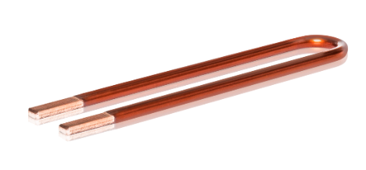
Rectangular conductors
Round conductors left some empty space in the slot due to geometrical shapes…
Basic idea: fullfill rectangular slot with rectangular conductors
Solution:
Hairpin

Slide 7
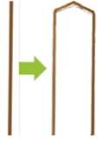
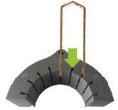
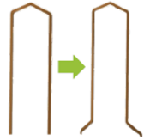
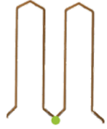
Manufactory main phases
Preparatory phase: straightening, stripping and cutting
Manufactory process: Shaping of the rectangular conductors, assembly in the stator, mechanical twisting, contacting
Shaping | Assembly | Twisting | Contacting
Contacting phase changes for mass production and prototyping

Slide 8
Contacting techniques
Mass production requires low cycle time, high reliability, automation of the process: Laser welding
Prototyping phase accepts high cycle time saving costs: soldering

Slide 9
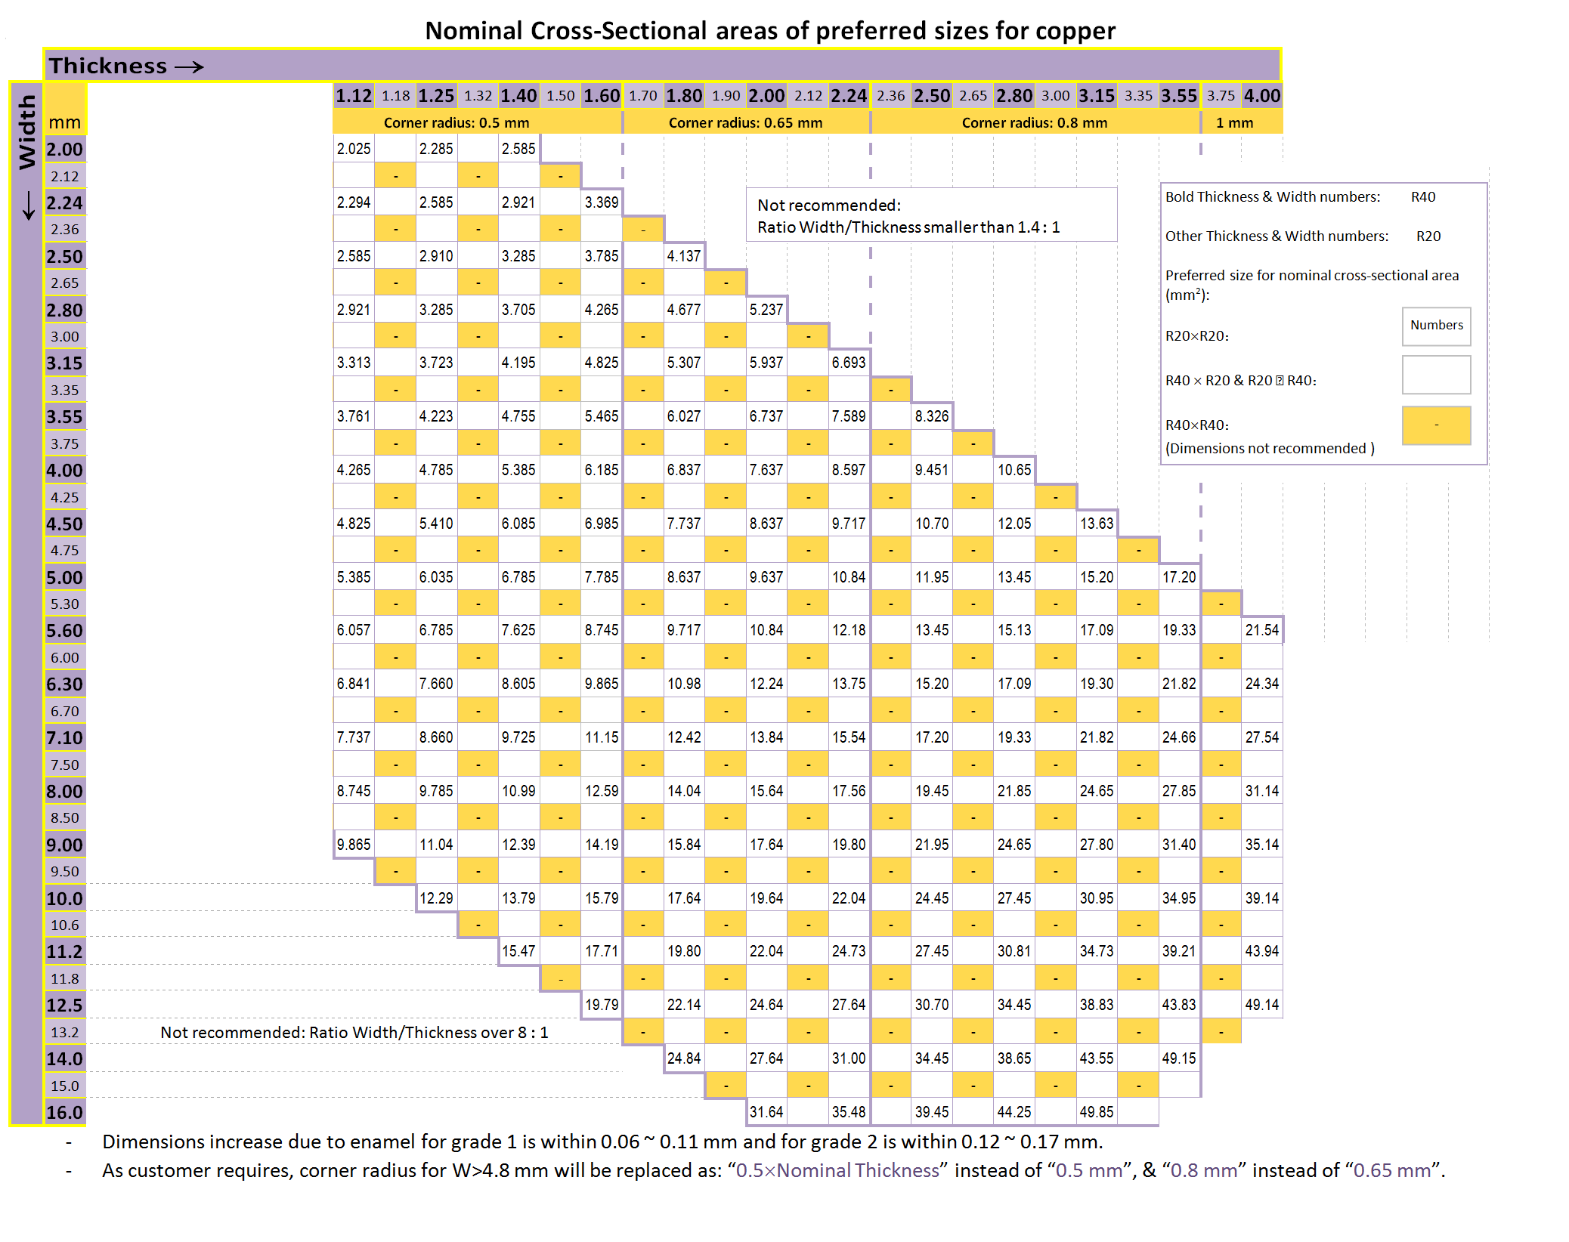
Reference standard for sizing
Sizing in rectangular conductors is predisposed by IEC60317-0-2 standard defining the recommended thickness vs width depending on the insulator grade

Slide 10
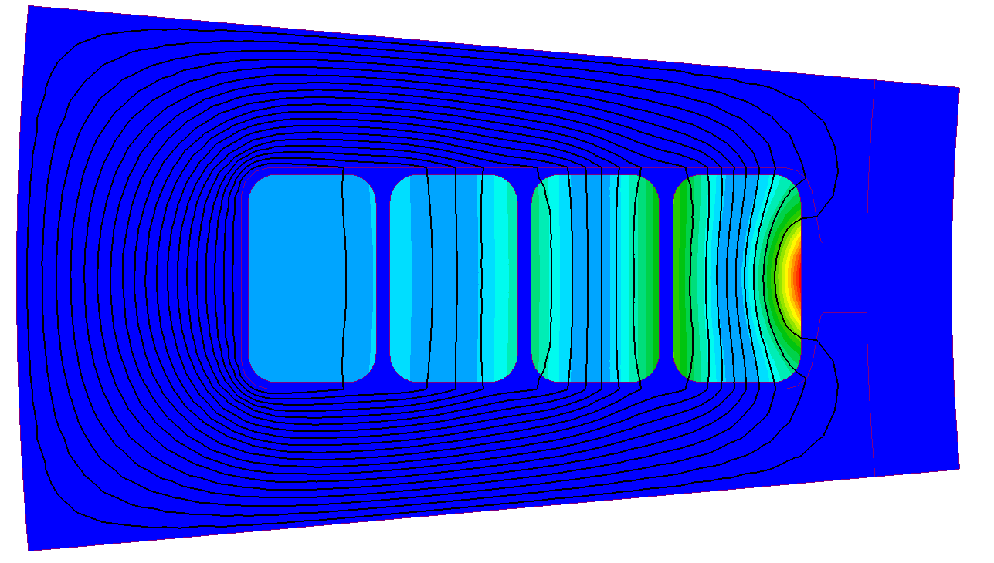
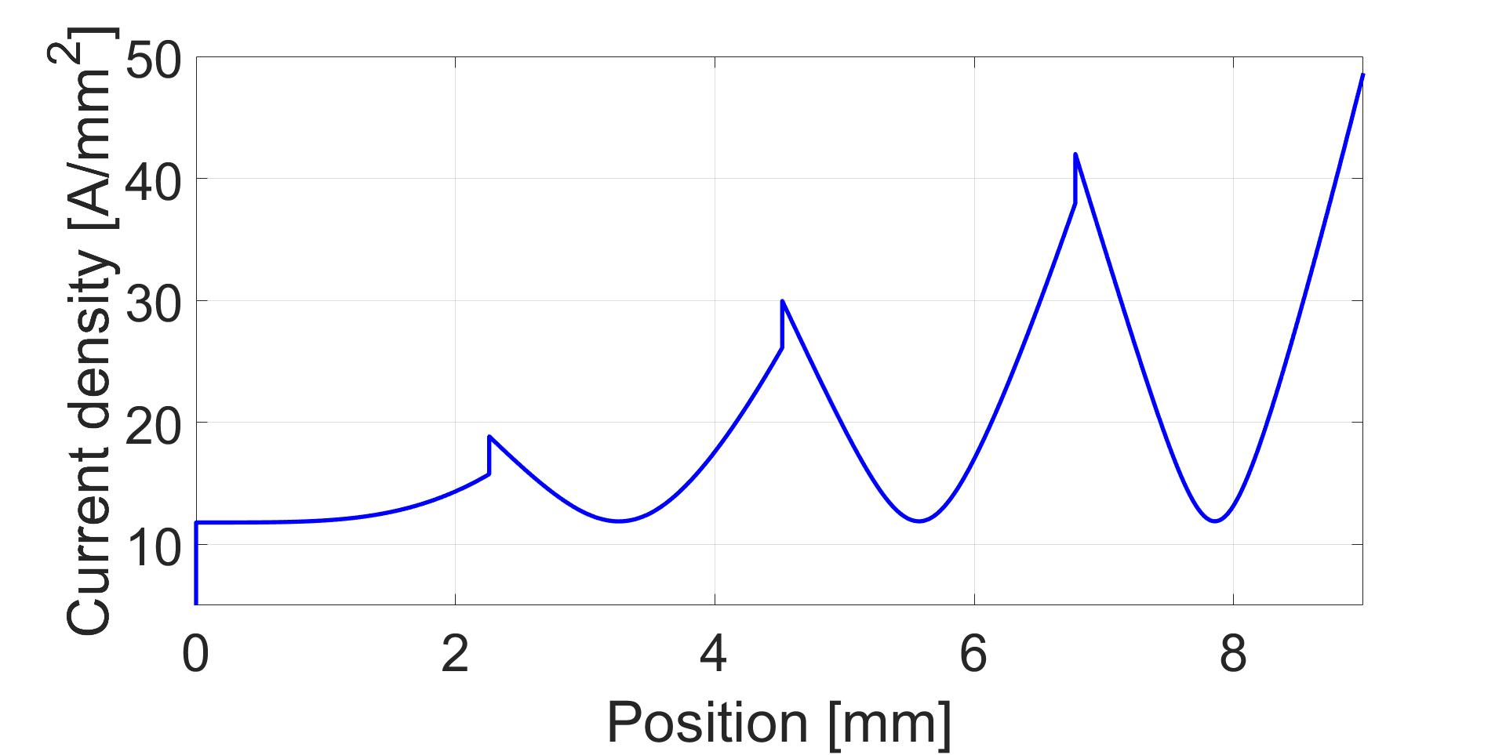
Standard hairpin winding
Conventional hairpin windings:
conductor size is fixed
current density is not omogenously disposed in the slot
Higher losses near the slot opening

Slide 11
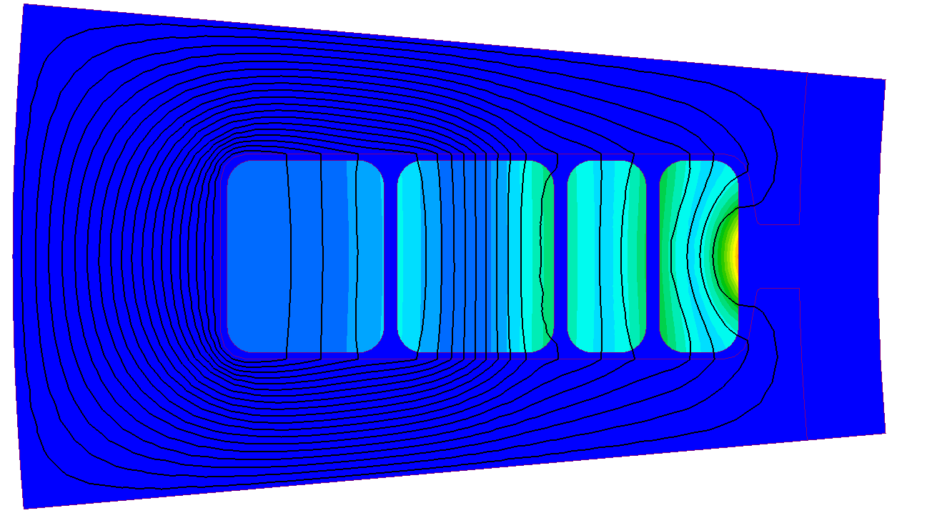
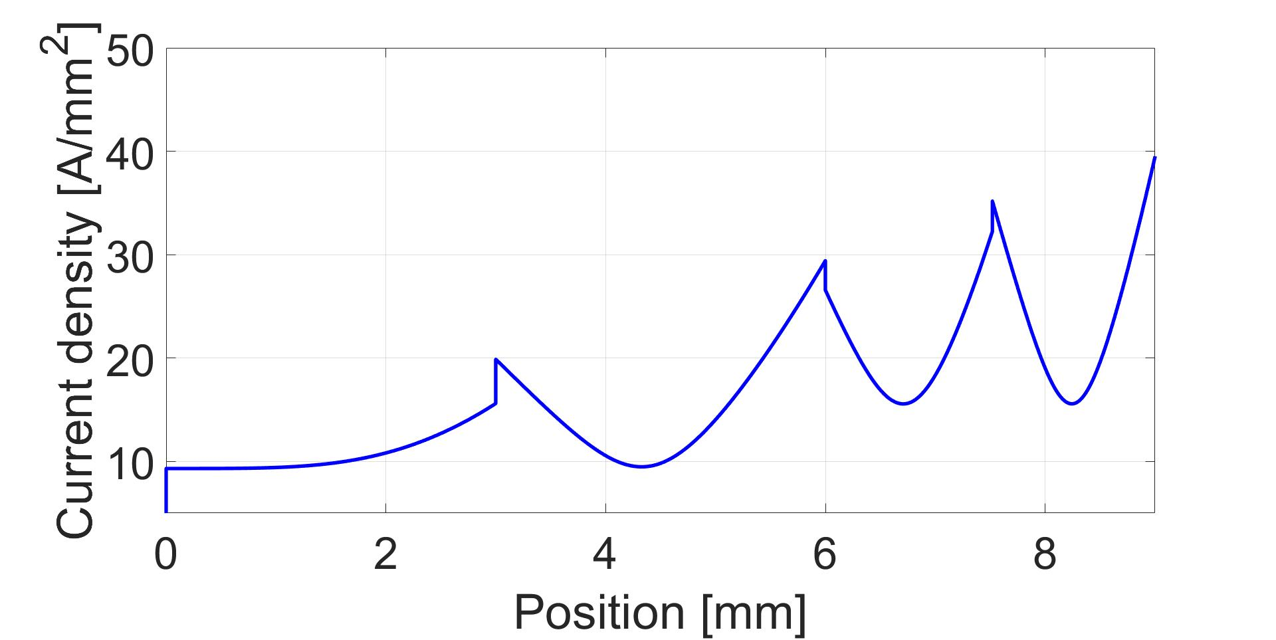
Innovative geometry: asymmetric hairpins
Basic idea:
Size reduction of conductors near the slot opening
Benefit:
Current density peaks reduction
Drawback:
It requires conductors of different size

Slide 12
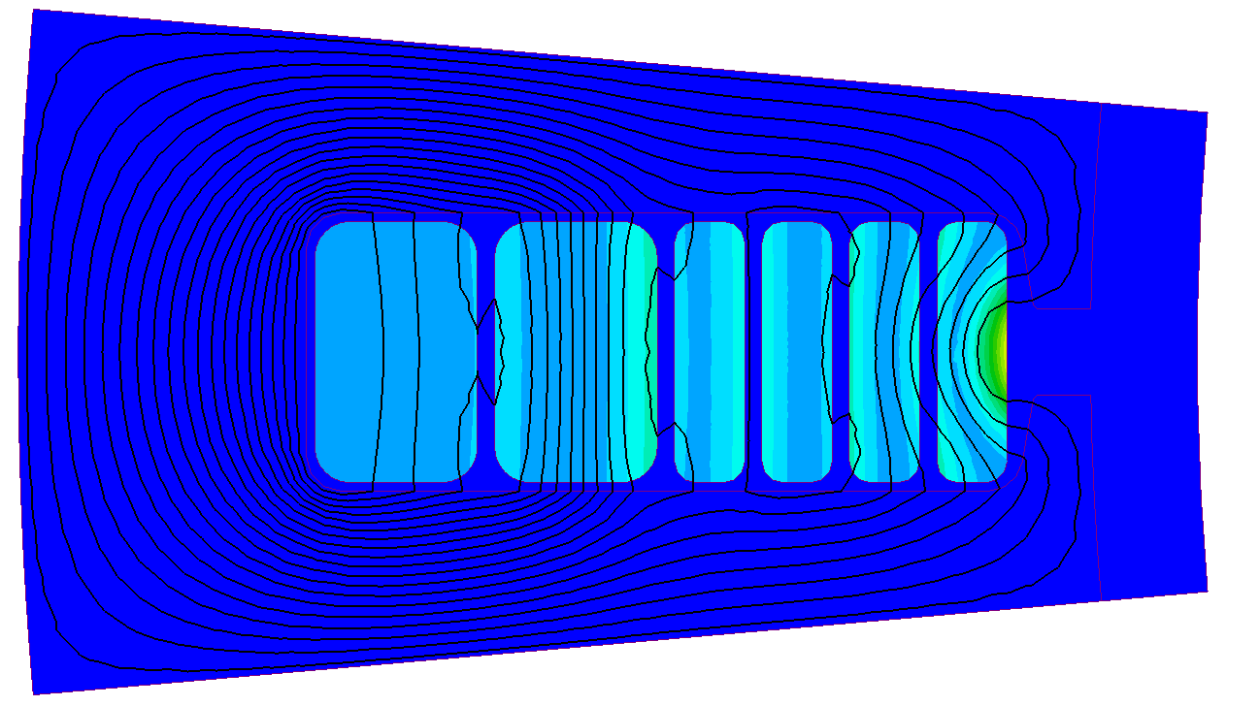
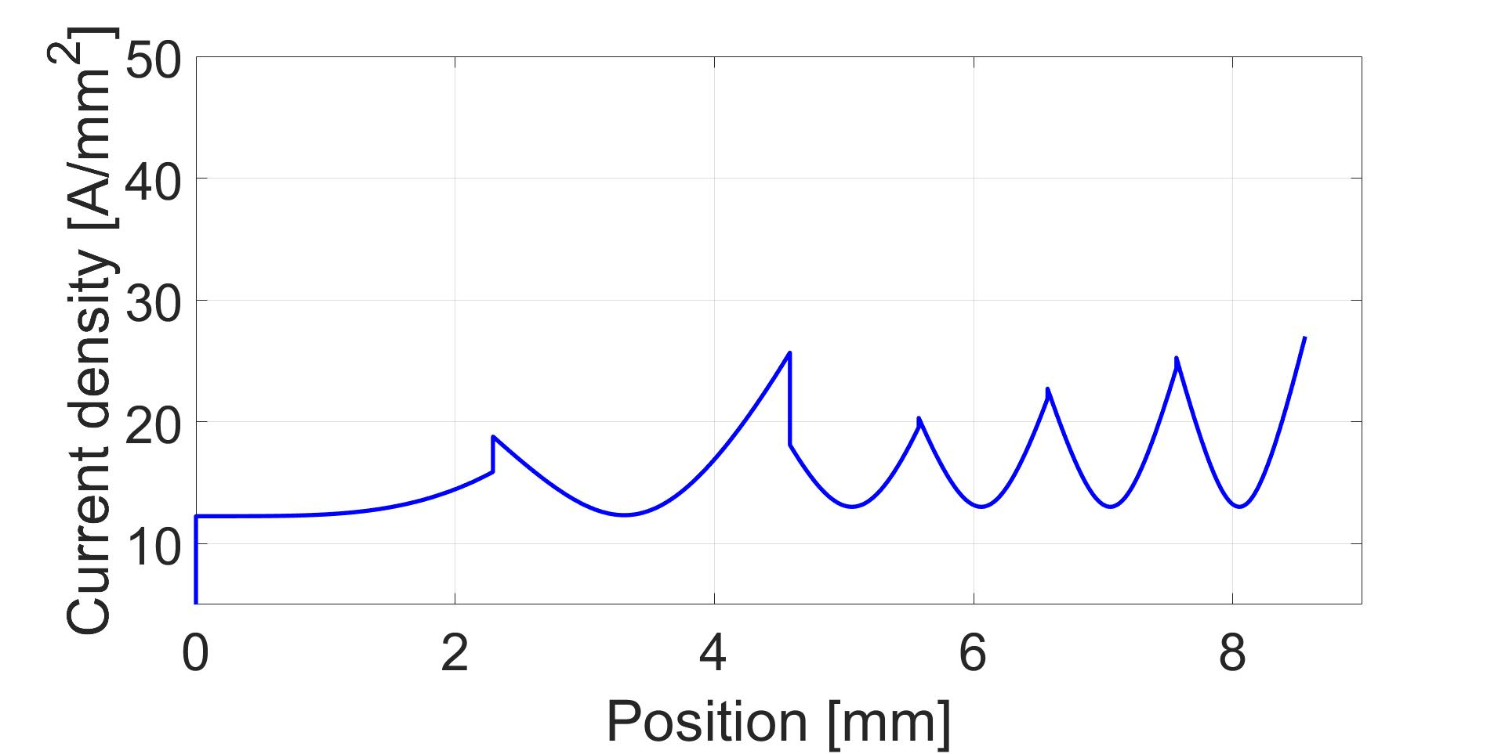
Innovative geometry: segmented hairpins
Basic idea:
Design of parallel paths in the slots
Benefit:
Further reduction of current density peaks with respect to asymmetric solution
Drawback:
Complex manufactory

Slide 13
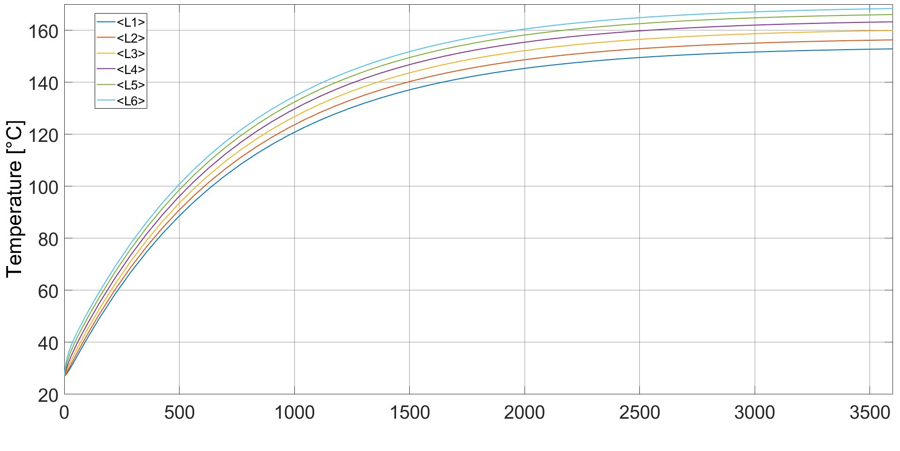
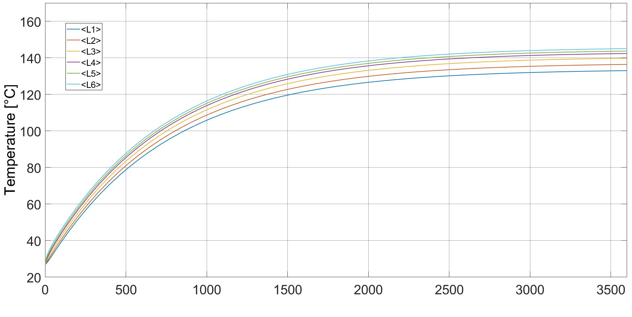
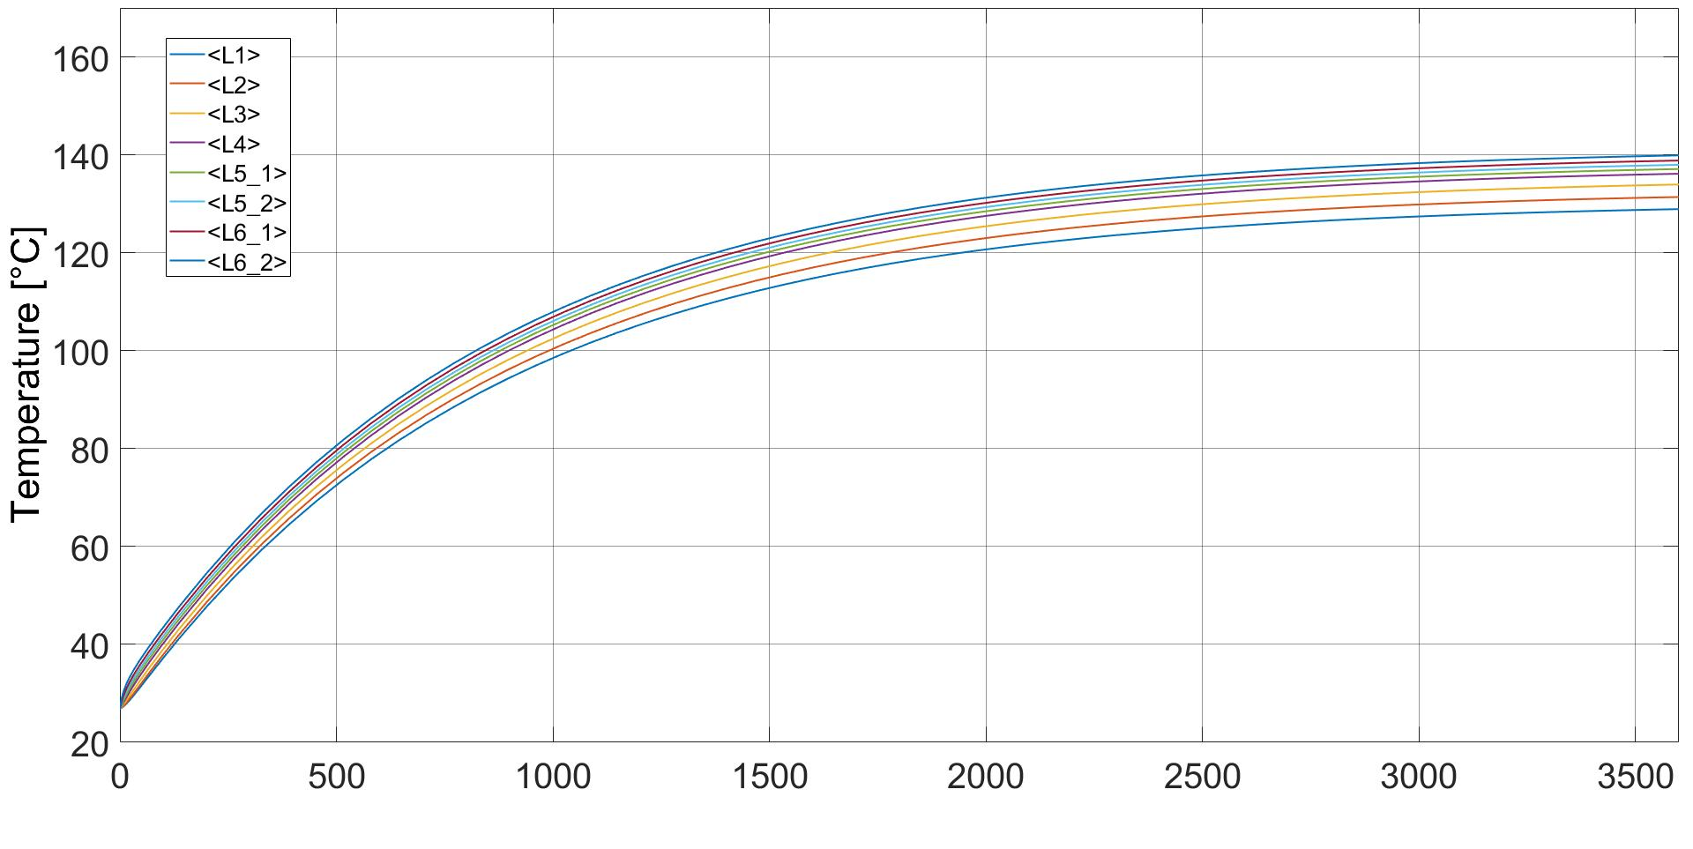
Thermal comparison
Conventional
TMAX=169°C
Loss reduction also affects the operative temperatures of the motor with non-negligible improvements
Asymmetric
TMAX=145°C
Segmented
TMAX=139°C

Slide 14
Thank you for your attention

